Slide 1
PROGRESS 2: ADDITIONAL data Bird song identification
Thanyaporn Phinthuphan
24 Jan 2019

Slide 2
Outline
Recap
Problem
Experiment
Next step

Slide 3
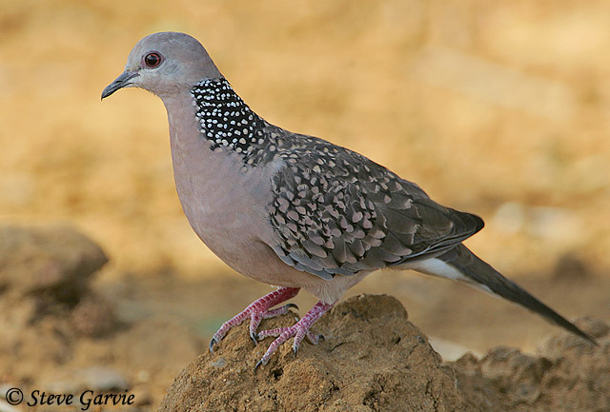
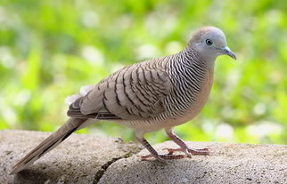
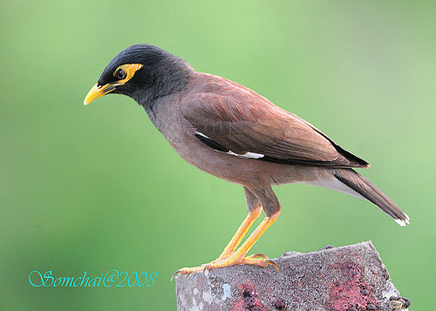
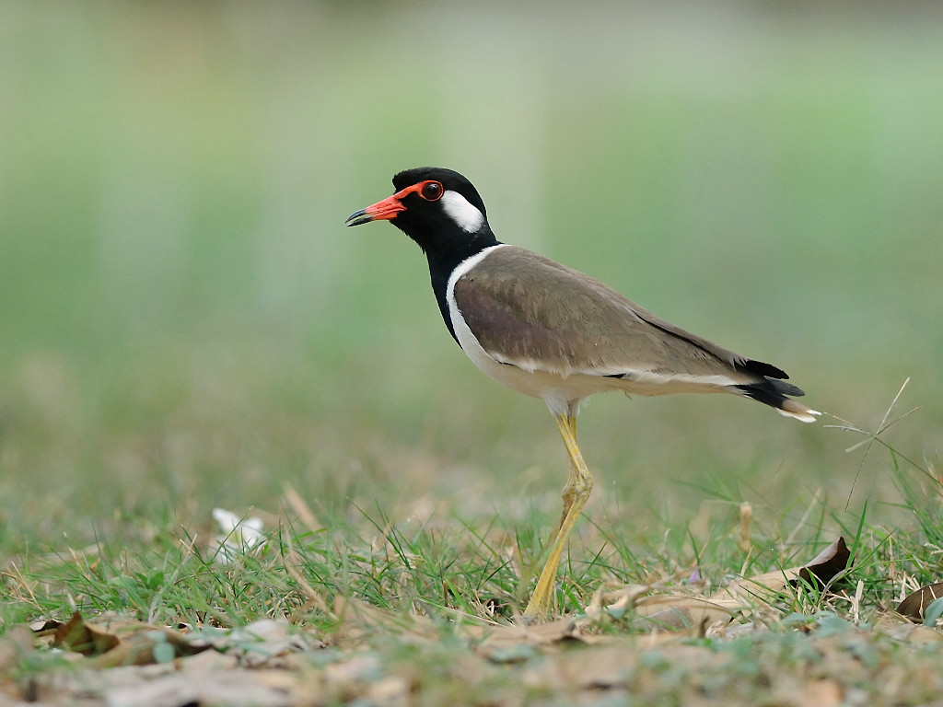
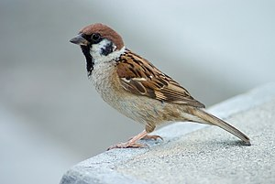
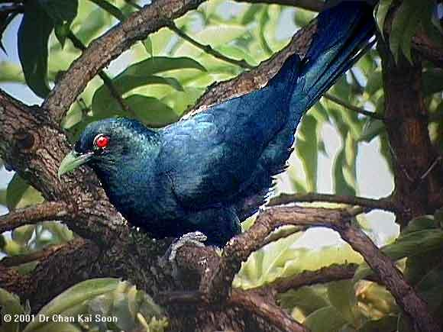
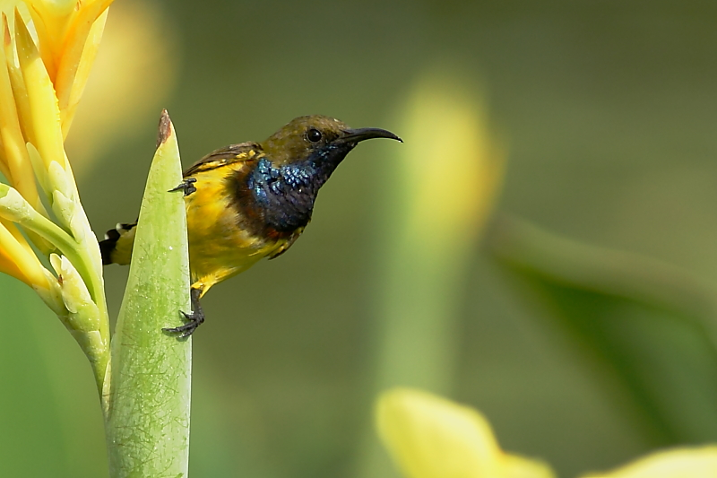
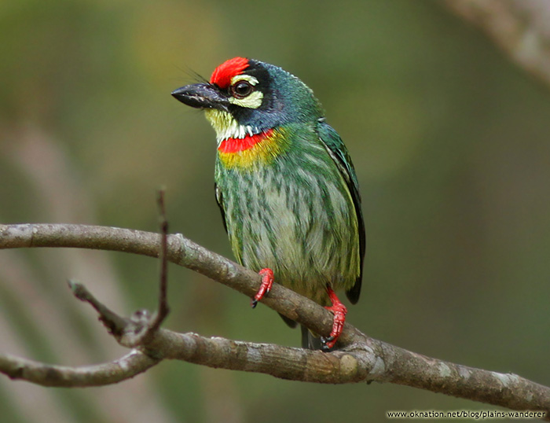
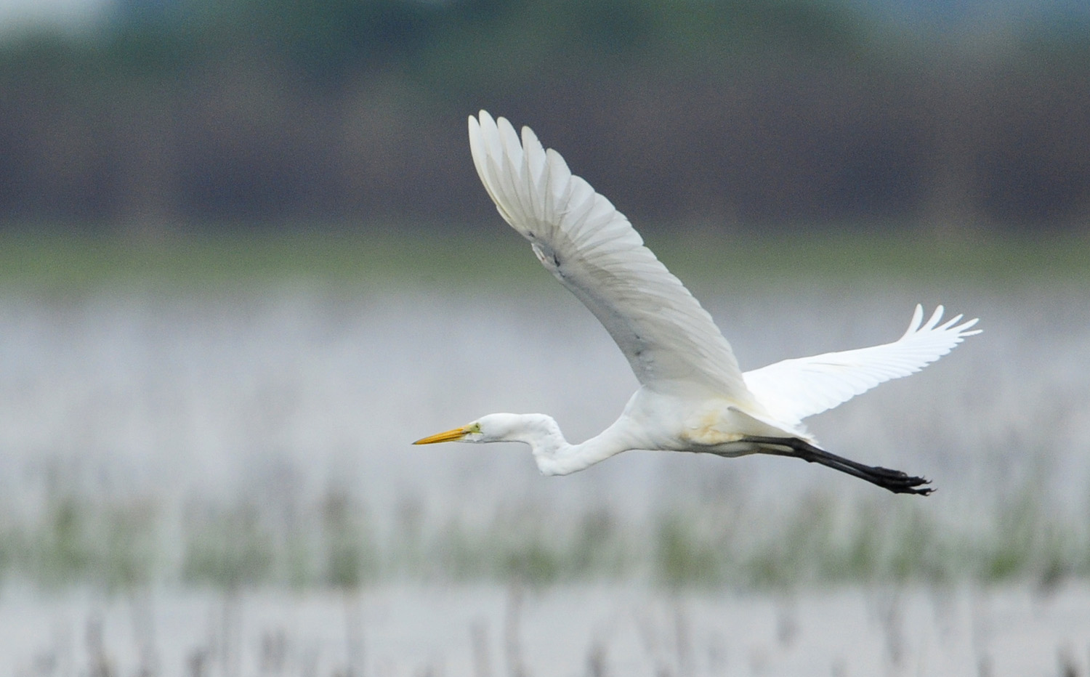
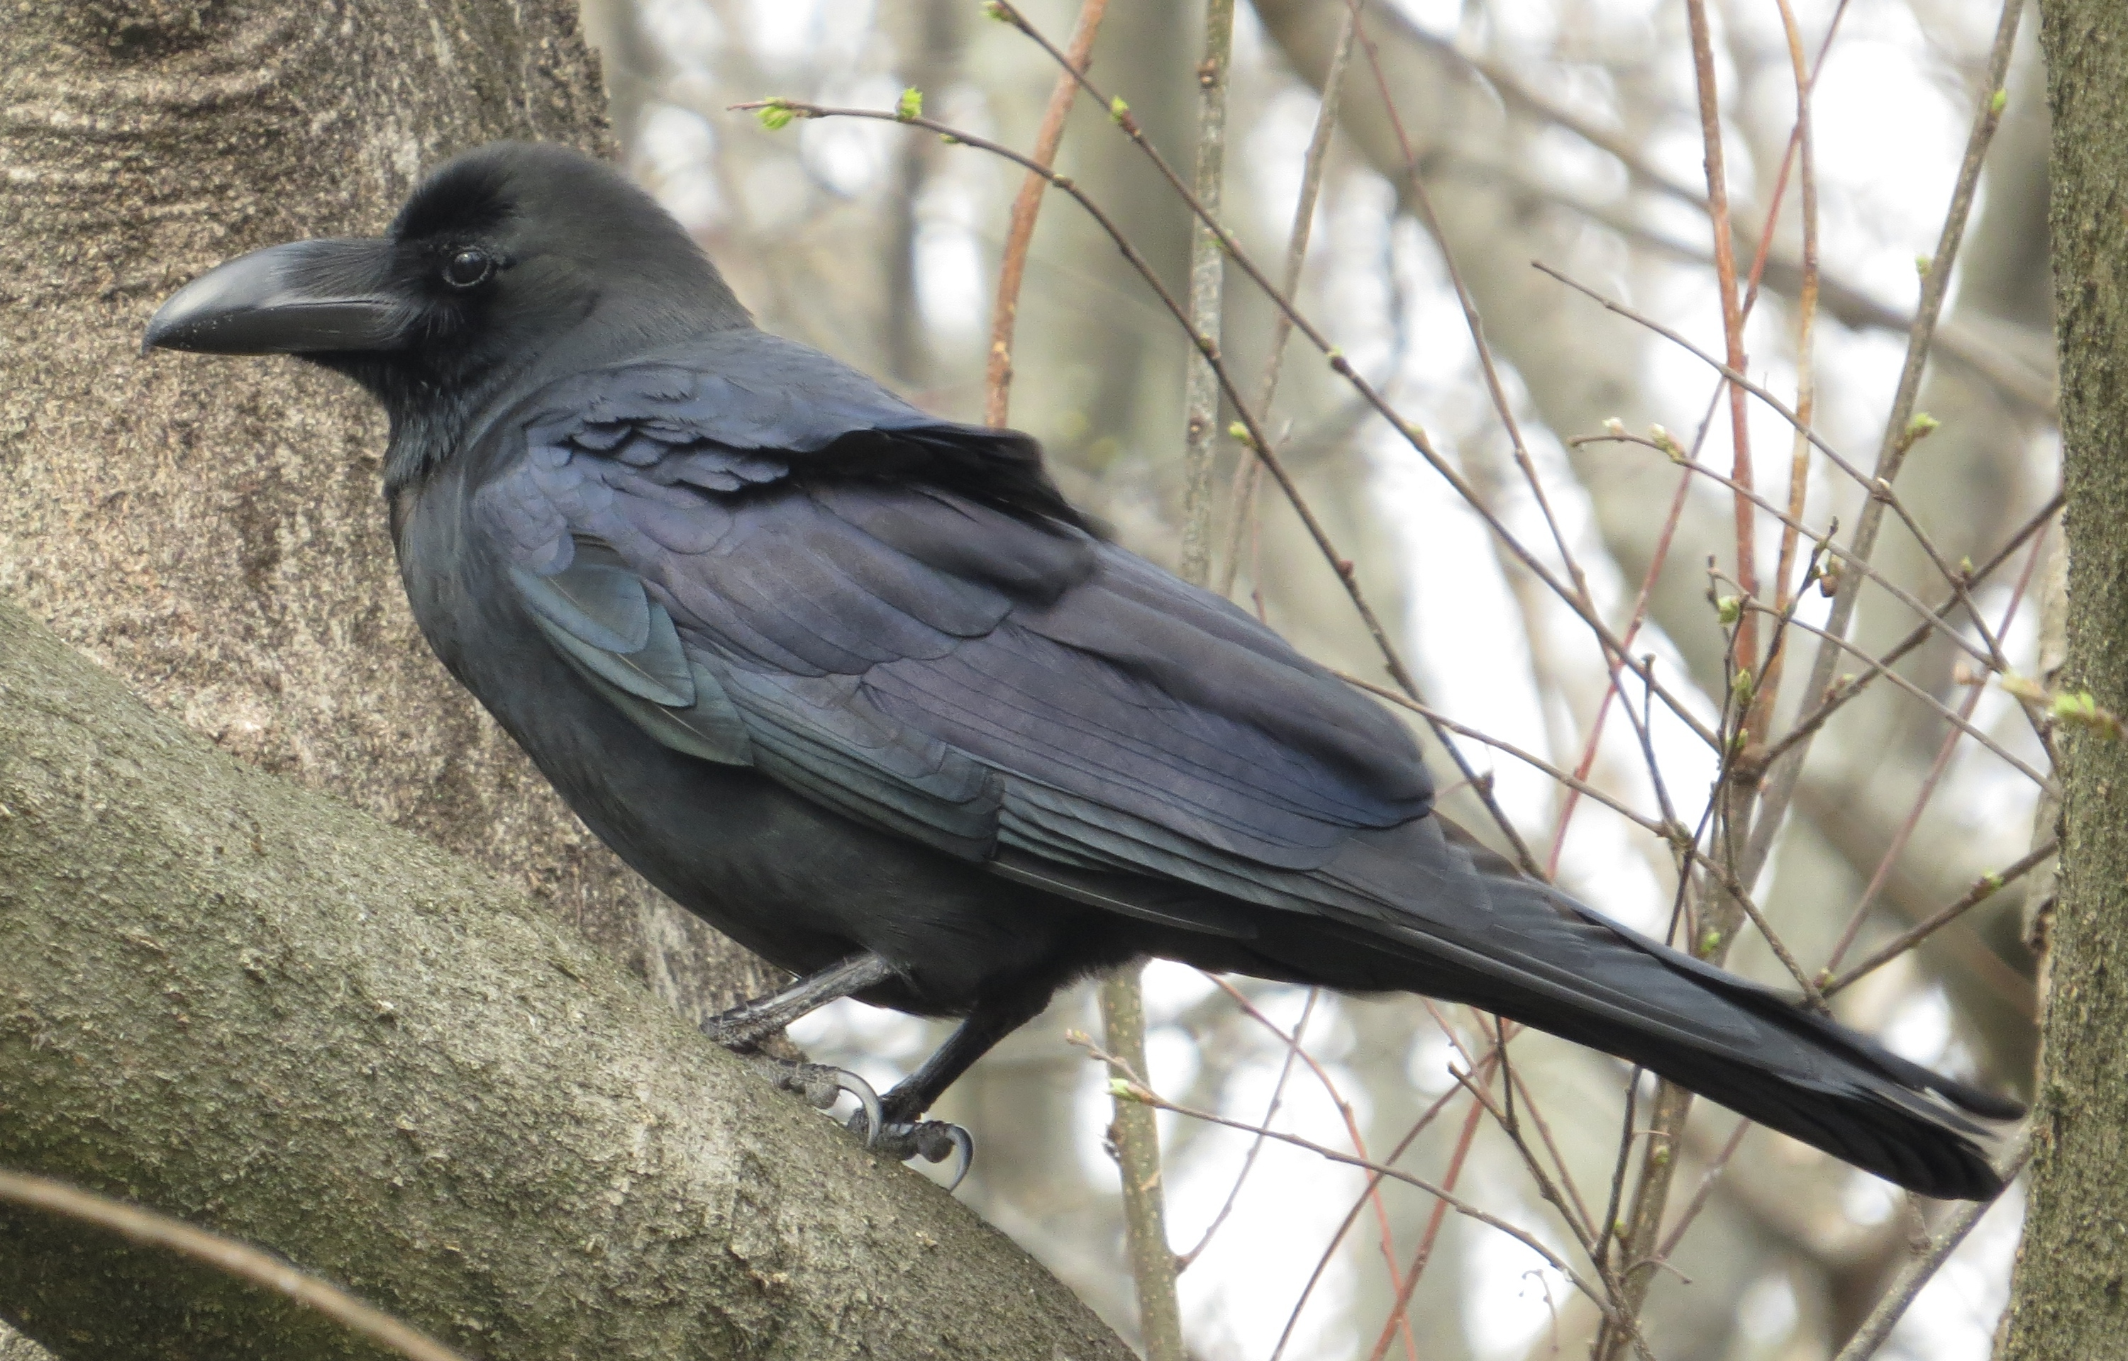
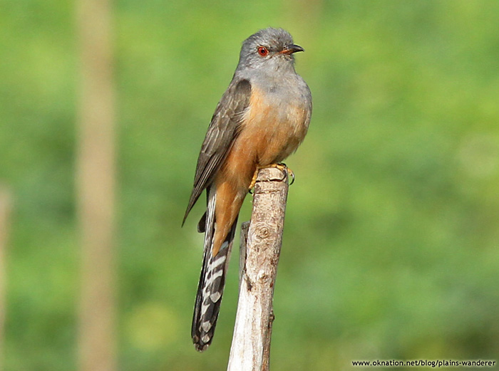
Recap
trained on 11 bird sound class with manual labeled 120 wav file (10 per class)
→ download all sound of 11 class with API → 1,847 file (100-200 per class)
goal: find the model that work on this data before append number of class

Slide 4
Problem Training data
label only 1 class per file but want multi-label result
mp3 to wav stereo (multi-channel) sound: node-lame → mean
quality of sound: using all / only A (~701) / A & B (~1,600)
sound type (call/song): combine / separate class
API download problem

Slide 5
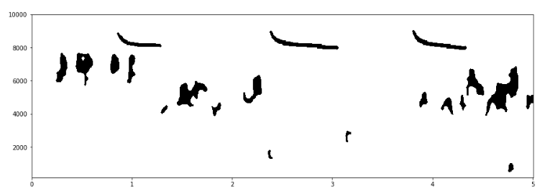
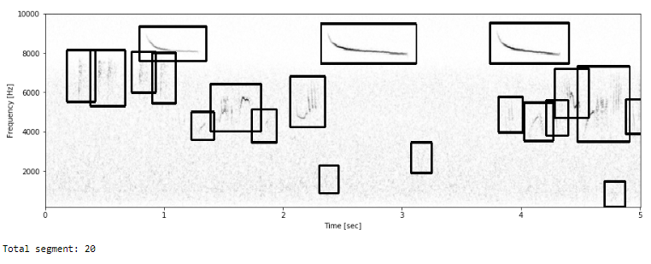
Problem Model algorithm
former model : feature = max correlation with segments in spectrogram
4,143 feature → 67,991 feature
prediction time ~ 1 times of sound length → ~ 20 times
too slowly !!!!!

Slide 6
Experiment Literature review from last semester
Bird identification from audio recordings (Rafael, 2013)
Clusterized MFCC & SVM for bird song identification (Olivier, 2013)

Slide 7
Experiment More literature review
Audio Based Bird Species Identification using Deep Learning Techniques
(Elias Sprengel, 2016) – Winning solution of BirdCLEF 2016
Bird Species Identification using Convolutional Neural Networks
(John Martinsson, 2017) – Master’s thesis in Computer Science, U. of Gothenburg

Slide 8
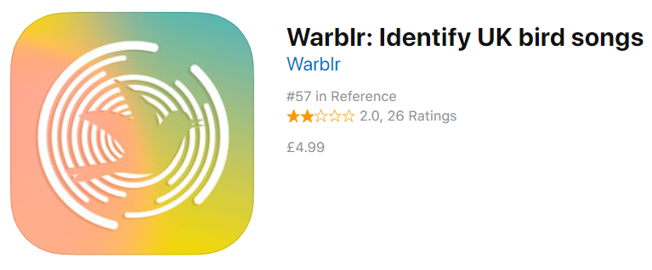
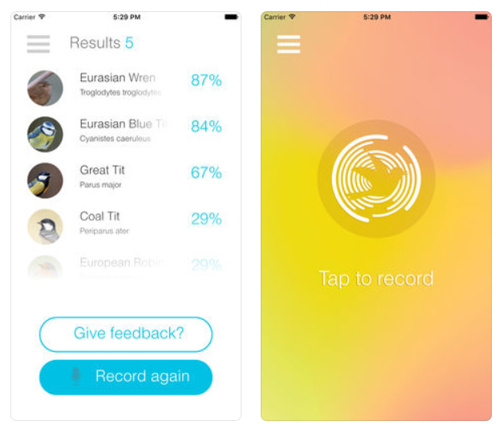

Experiment Real application

Slide 9
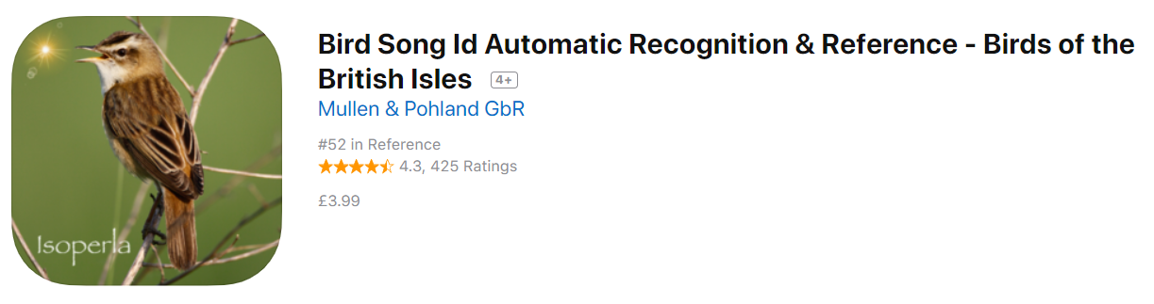
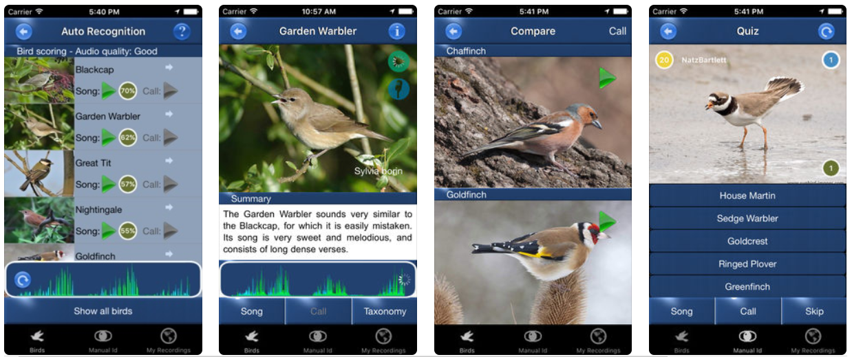
Experiment Real application

Slide 10

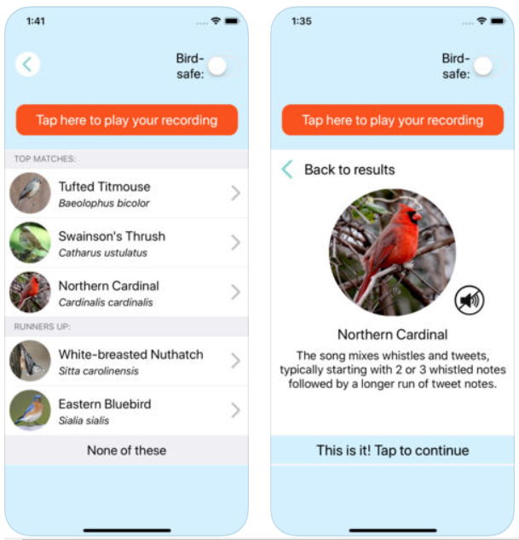


Experiment Real application

Slide 11
Next Step
find the best model on 11 class: good AUC / recall / prediction time
define new scope and test
test with real data (manual record / data from other website)
write UI to use on mobile phone
test in the park on mobile phone

Slide 12
Q&A

Slide 13
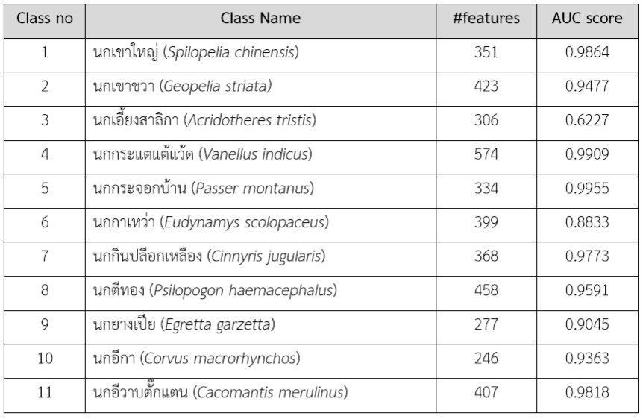
Result On Thai birds data
ประเมินผลด้วยค่า AUC score
ใช้วิธี 5-Fold Cross Validation
AUC score เฉลี่ยเท่ากับ 92.6%

Slide 14
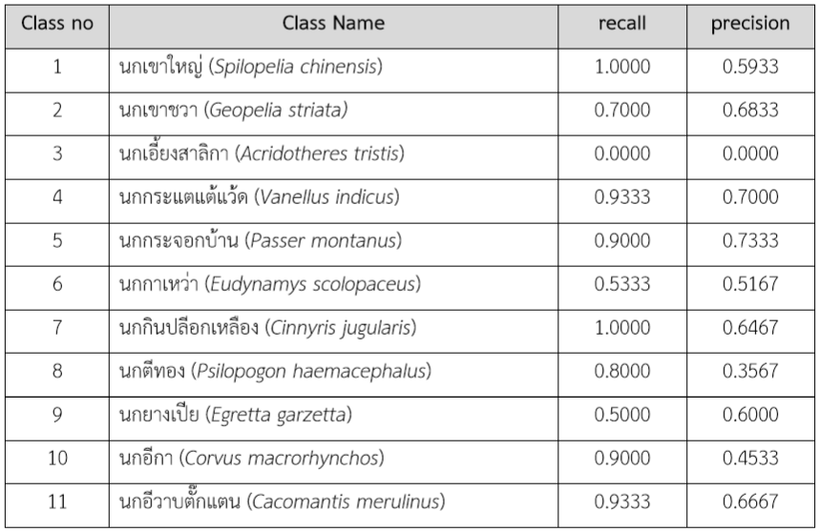
Result On Thai birds data
โมเดลที่ได้จึงควรมีค่า recall ที่มาก
เลือกค่า threshold เท่ากับ 0.11
recall เท่ากับ 74.55%
precision เท่ากับ 54.09%

Slide 15

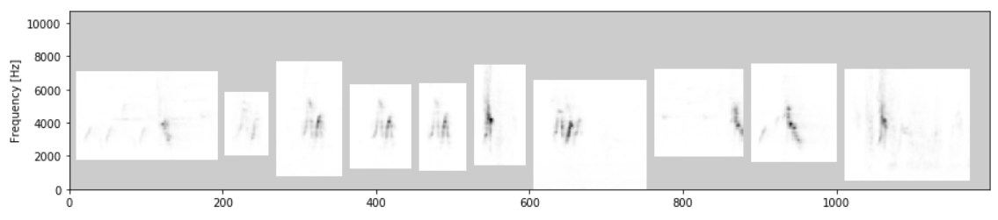
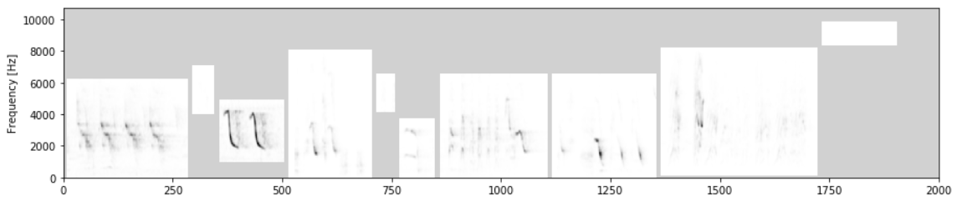
Result On Thai birds data
นกกระจอกบ้าน (AUC score 0.9955)
นกเอี้ยงสาลิกา (AUC score 0.6227)

Slide 16
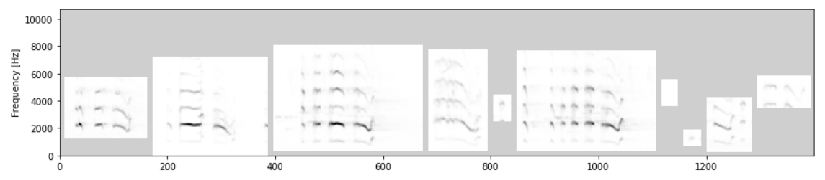
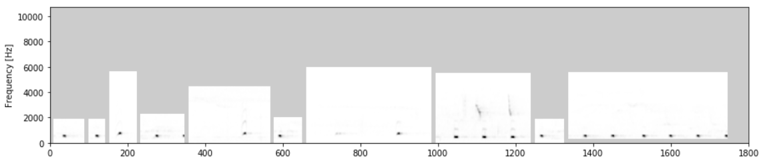
Result On Thai birds data
นกกระแตแต้แว้ด (AUC score 0.9909)
นกตีทอง (AUC score 0.9591)

